Slide 1

COVID-19
STIMULUS MEASUREMENT AND OPTIMIZATION
Presented by:
Pani Maddi
Tory Young
David Frazier
Bob Benton

Slide 2
Economic Stimulus Data
National Economic Data
Personal Expenditure Data
Unemployment Rates
-National Unemployment -State Unemployment
Consumer Expense Data
-Housing -Food -Transportation
-Healthcare
-Etc.
Gross Domestic Product
Consumer Price Index
Household Income
S&P 500 / Dow Jones Index
Disposable Income
National Debt
Net Worth

Slide 3
FOCUS
Impact of Stimulus on the Consumer
Consumer
Businesses
Our primary goal in this study was to focus on the consumer. We reviewed previous recessions and stimulus efforts to predict whether the recent stimulus package would make a sizable impact for the consumer and the economy as a whole.
A large portion of the stimulus was reserved for distressed businesses. While our study focused on the consumer, we acknowledge the large impact the stimulus has on small businesses.

Slide 4

Data Sources
FRED – Federal Reserve Economic Data
FRED provides access to hundreds of economic data points available through CSV or API.
Bureau of Labor Statistics
The Bureau of Labor Statistics provided a wealth of detail on personal economic data such as consumer expenditure and disposable income.

Slide 5
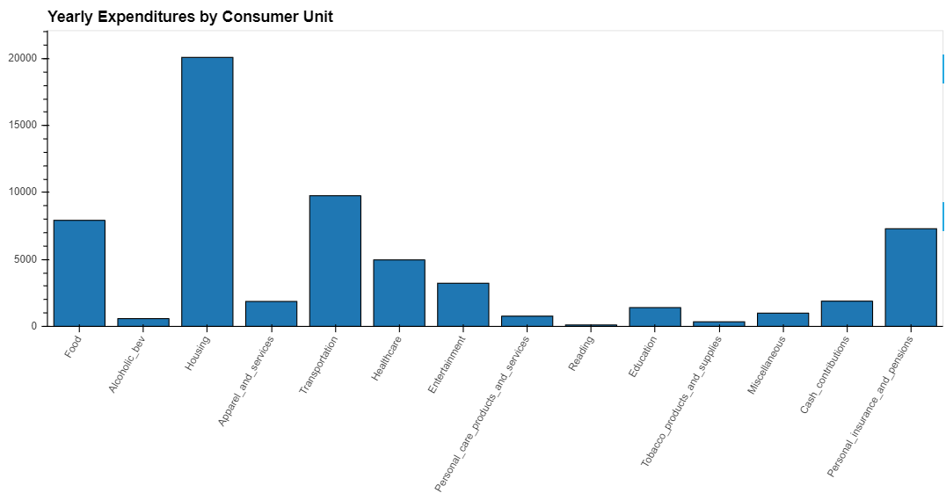
Visualizations
+
Economic Data Dashboard
+
Consumer Data Dashboard

Slide 6


Twilio – Mobile Alerts
Twilio API
Using Twilio’s API combined with the data API of FRED, we can set up alerts based on certain thresholds in our data.

Slide 7
Projected Effective Stimulus
Stimulus based on Average Expenses
Timeframe for Effective Stimulus
Housing Costs: $1000
Initial Stimulus payment should be three months worth of the averages calculated here.
Food Costs: $300 (family size 1-3)
$450 (family size 4-6)
$600 (family size 7+_
$4650 initial stimulus payment for family of 1-3
Transportation Costs: $250
$200,000 maximum annual household income for stimulus

Slide 8
Recap
Discuss findings of data analysis and impact of COVID-19 stimulus.
Presented by:
Pani Maddi
Tory Young
David Frazier
Bob Benton

